Slide 1
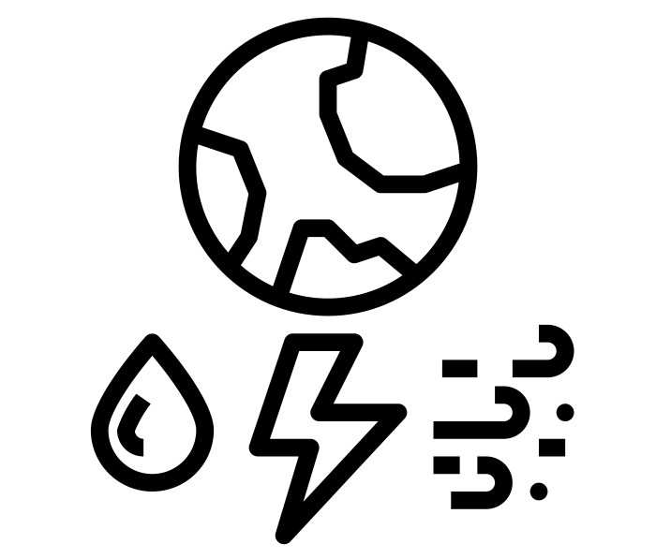
Teachers Notes
Each team of 3 will need:
(Teachers need to handpick teams)
½ a plastic bin liner
25 straws per team
½ pack of blue tak
1 A5 cardboard base
2 pieces of paper
In total, each class will have 8 teams
4 bin liners
200 paper straws
Milestone/Sticky Knowledge:
Understand that humans make an impact on the environment which can have positive or negative consequences.
Can recognise how buildings and settlements are constructed to take the environment into consideration (to withstand earthquakes, monsoons etc)
Medium Term Plan
The aim of this session is to get the children to think about the Power of nature and how a structure can survive. There will be a design challenge in groups of 3.
The structure will be placed on the Nixon roof for 3 days and nights.
The children will need to think about how the design
Please can you teach this lesson later in the week -after the Tuesday assembly

Slide 2
The Big Question is…
How can we harness the power of nature?

Slide 3
Year 4 Topic Design Challenge
Create a structure which can withstand the power of nature for 3 days and nights in Singapore.
Resources:
Paper Straws
Blue tak
½ a bin liner bag (plastic)
1 A5 cardboard base
Scissors
2 pieces of paper -recycled from the printer
Rules:
You can not use any other resources.
It must fit on the cardboard base
It needs to be transported from the classroom to the testing zone
Each person in the group must have a role
You only have 30 minutes to create your structure

Slide 4
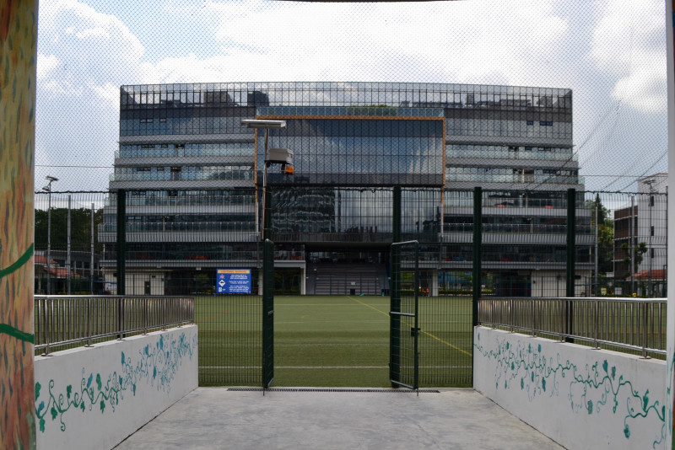
It will be left on the Nixon Building Roof for 3 days and 3 nights
What do you think your team need to consider when designing your structure?
Global Guardians will take them to the Nixon Building once created

Slide 5

What is the Power of Nature?
Draw as many examples as you can think of…
(2 minutes)

Slide 6
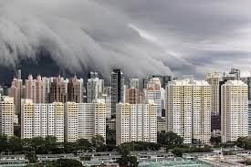
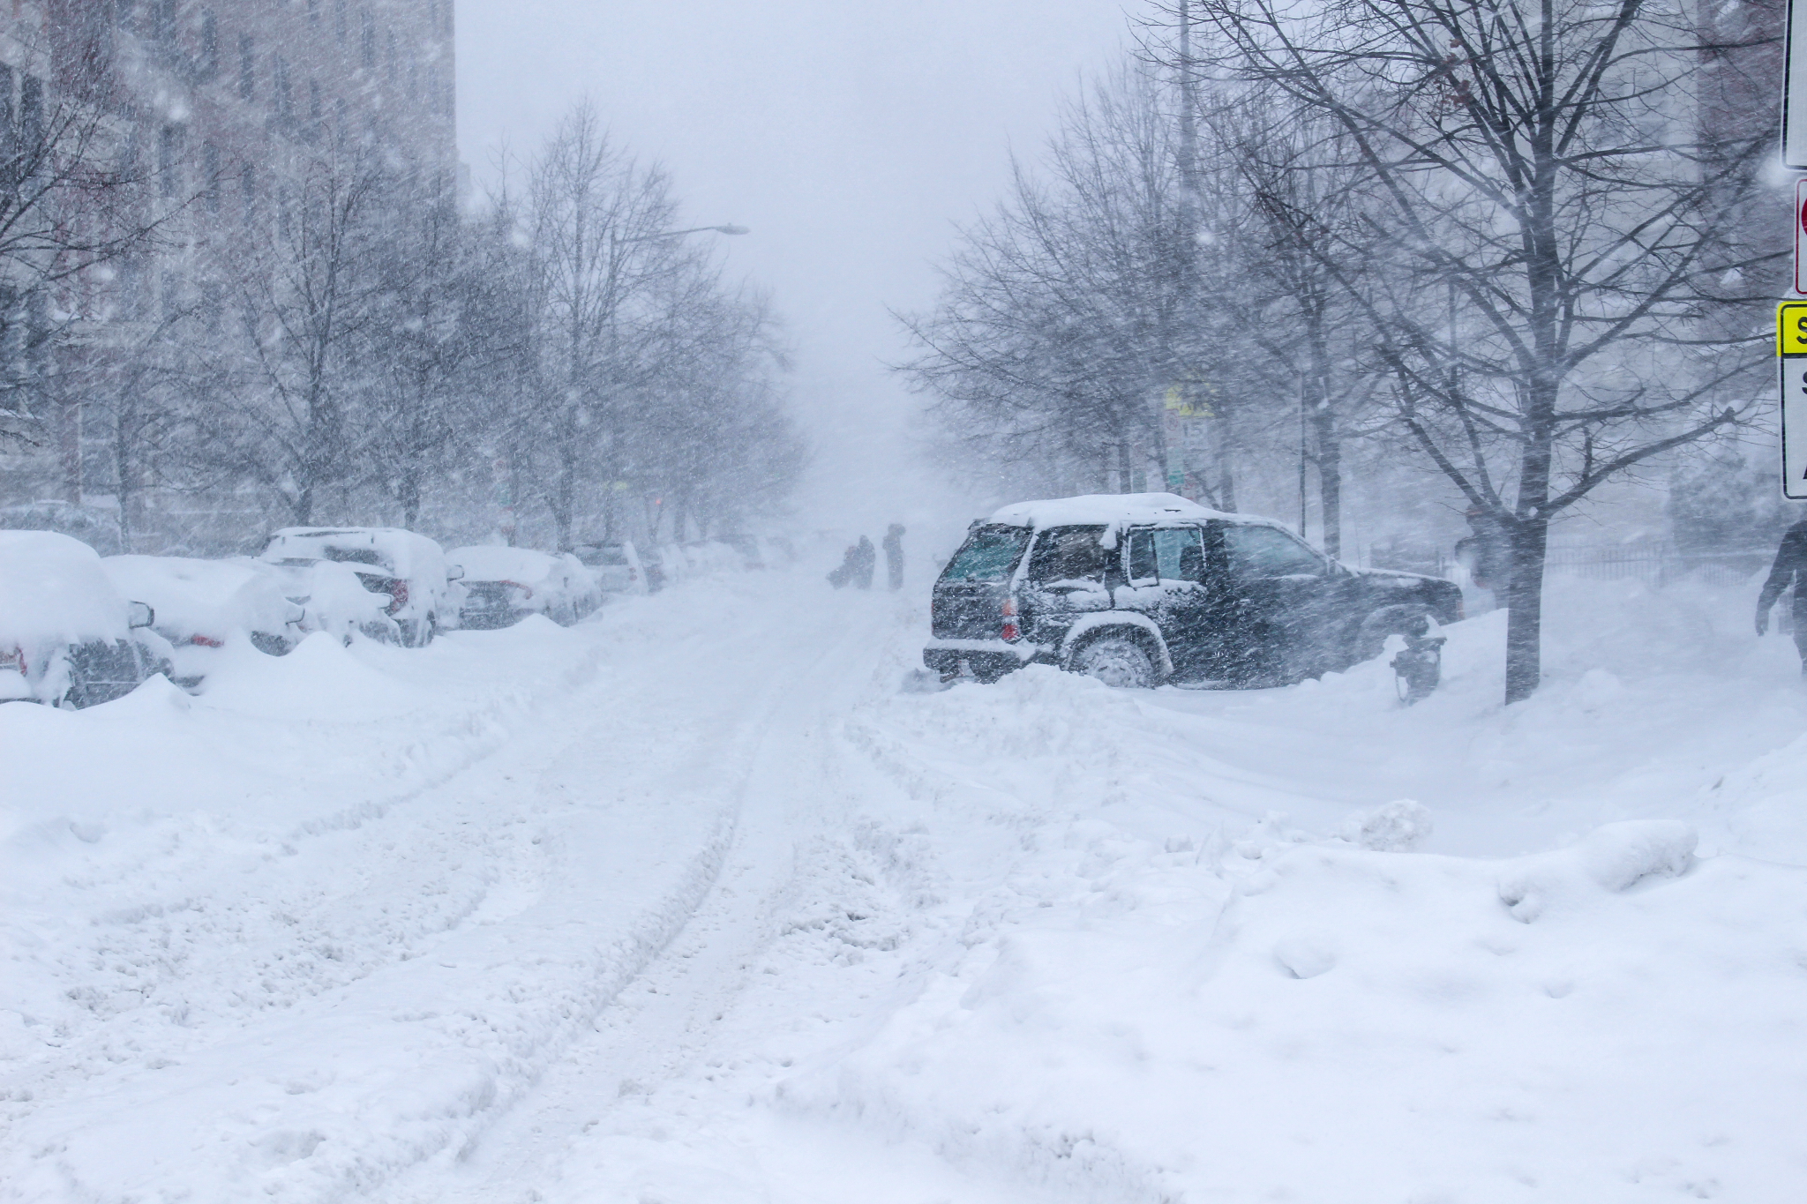
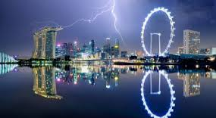
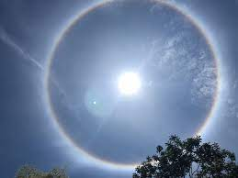
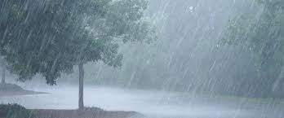
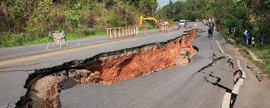
What is the Power of Nature?
Which affect Singapore?

Slide 7

Design Ideas and Designs
Use your table to generate questions and design sketches
Rules:
You can not use any other resources apart from what is in your packs and scissors to cut
It must fit on the cardboard base
It needs to be transported from the classroom to the testing zone
Each person in the group must have a role
You only have 30 minutes to create your structure
Questions to think about when building your structure
Design Sketches
Take a photo of your sketches and ideas

Slide 8

Time to Create
Create a structure which can withstand the power of nature for 3 days and nights in Singapore.
Resources:
Paper Straws
Blue tak
½ a bin liner bag (plastic)
1 A5 cardboard base
Scissors
2 pieces of paper -recycled from the printer
DON’T FORGET TO WRITE YOUR NAMES & CLASS ON!
Rules:
You can not use any other resources.
It must fit on the cardboard base
It needs to be transported from the classroom to the testing zone
Each person in the group must have a role
You only have 30 minutes to create your structure

Slide 9

Take a ‘Before’ Photo
Keep all 8 structures somewhere safe in your class. They will be collected and taken to the Nixon on Thursday or Friday!

